Slide 1
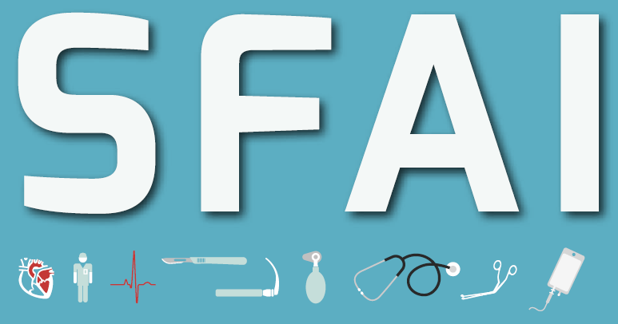
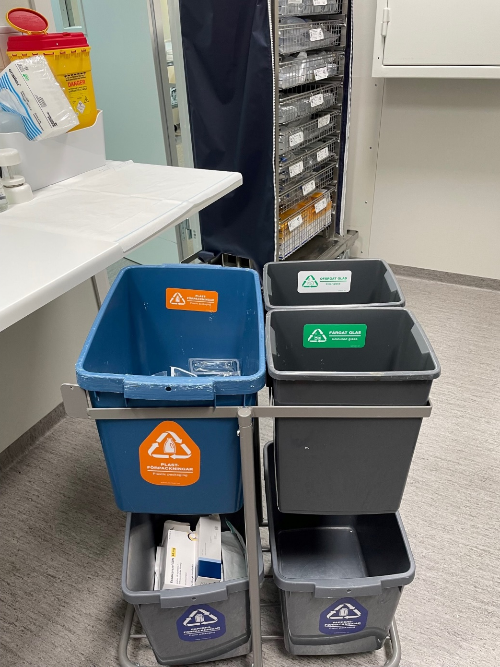
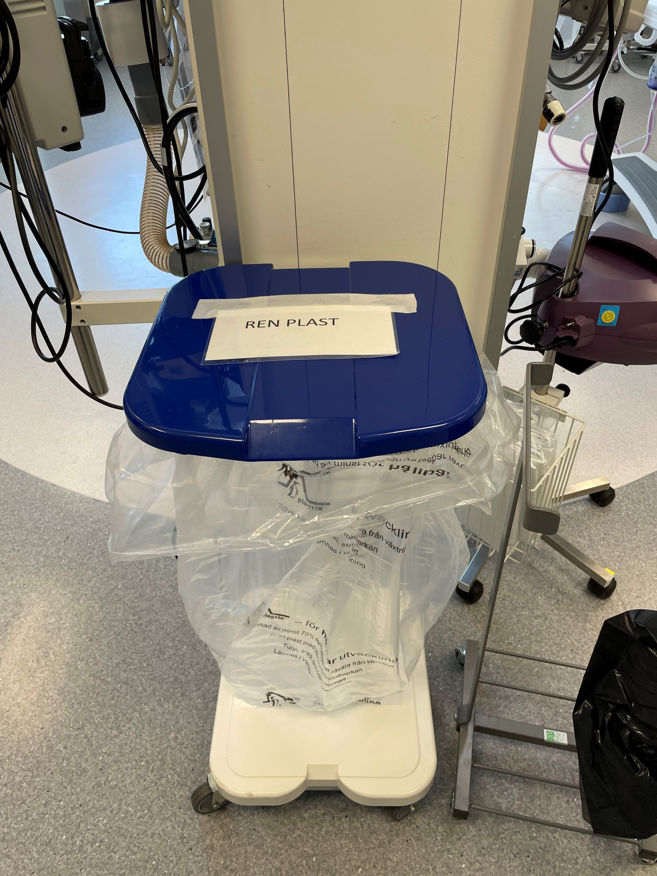
Sustainability in Anaesthesia and Intensive care in Sweden
Environmental sustainability is an important part of the Swedish society in general. The law that regulates environmental issues include that packageing is recycled everywhere in the society, including the hospitals.
The pictures shows how this can be done bedside. It must be easy to do it correct!
Left: A recycling station at a nurse station at the ICU in Linköping University Hospital – plastics, cardboard, paper, clear glass and coloured glass is collected when drugs are prepared.
Right: In one of the OR, a recycling bag for clean plastic packageing stands next to a general garbage bin.
The Swedish Society of Anaesthesia and Intensive Care Annual Meeting
2021 Symposium about volatile anaesthetics and their environmental effects
2022 Symposium about reducing plastics used in ICU and OR
A joint meeting with anaesthetic and intensive care nurses – sharing knowledge with each other.
Planned activities:
Autumn 2023 – annual meeting together with surgical societies – discussing how to reduce our enviromental imprint from the OR
Pros and Cons in Sweden
Local anaesthetics/blockades is used frequently – less volatiles
Low flow anaesthesia – modern equipment and skilled nurses using them
Cost-effectivness must be used (by law) when purchasing all kinds of material for a hospital – the packaging or environmental footprint is of less value when decisions are done
Single use items are cheaper than reusing/resterilizing instruments or textiles.

